Slide 1
Joint Surface Generation

Slide 2
Estimating the three-dimensional joint roughness coefficient value of rock fractures Ping Mo, Yanrong Li
Bull Eng Geol Environ (2019) 78:857–866

Slide 3
Measurement Formula

Slide 4
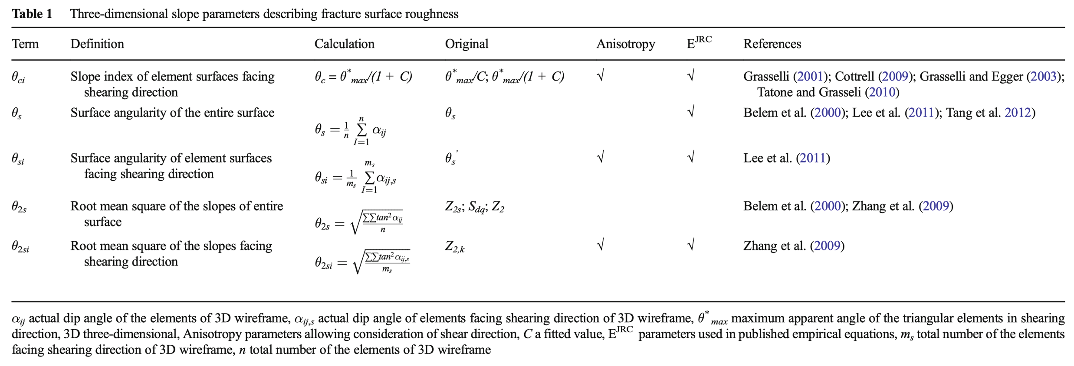
Surface Roughness Mesaurements
Surface roughness measurement by slope angle

Slide 5
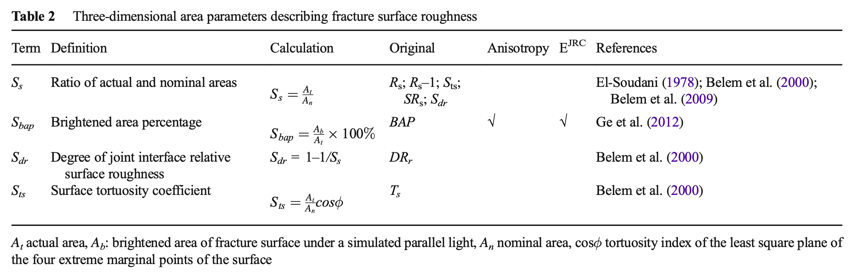
Surface Roughness Mesaurements
Surface roughness by area parameters

Slide 6
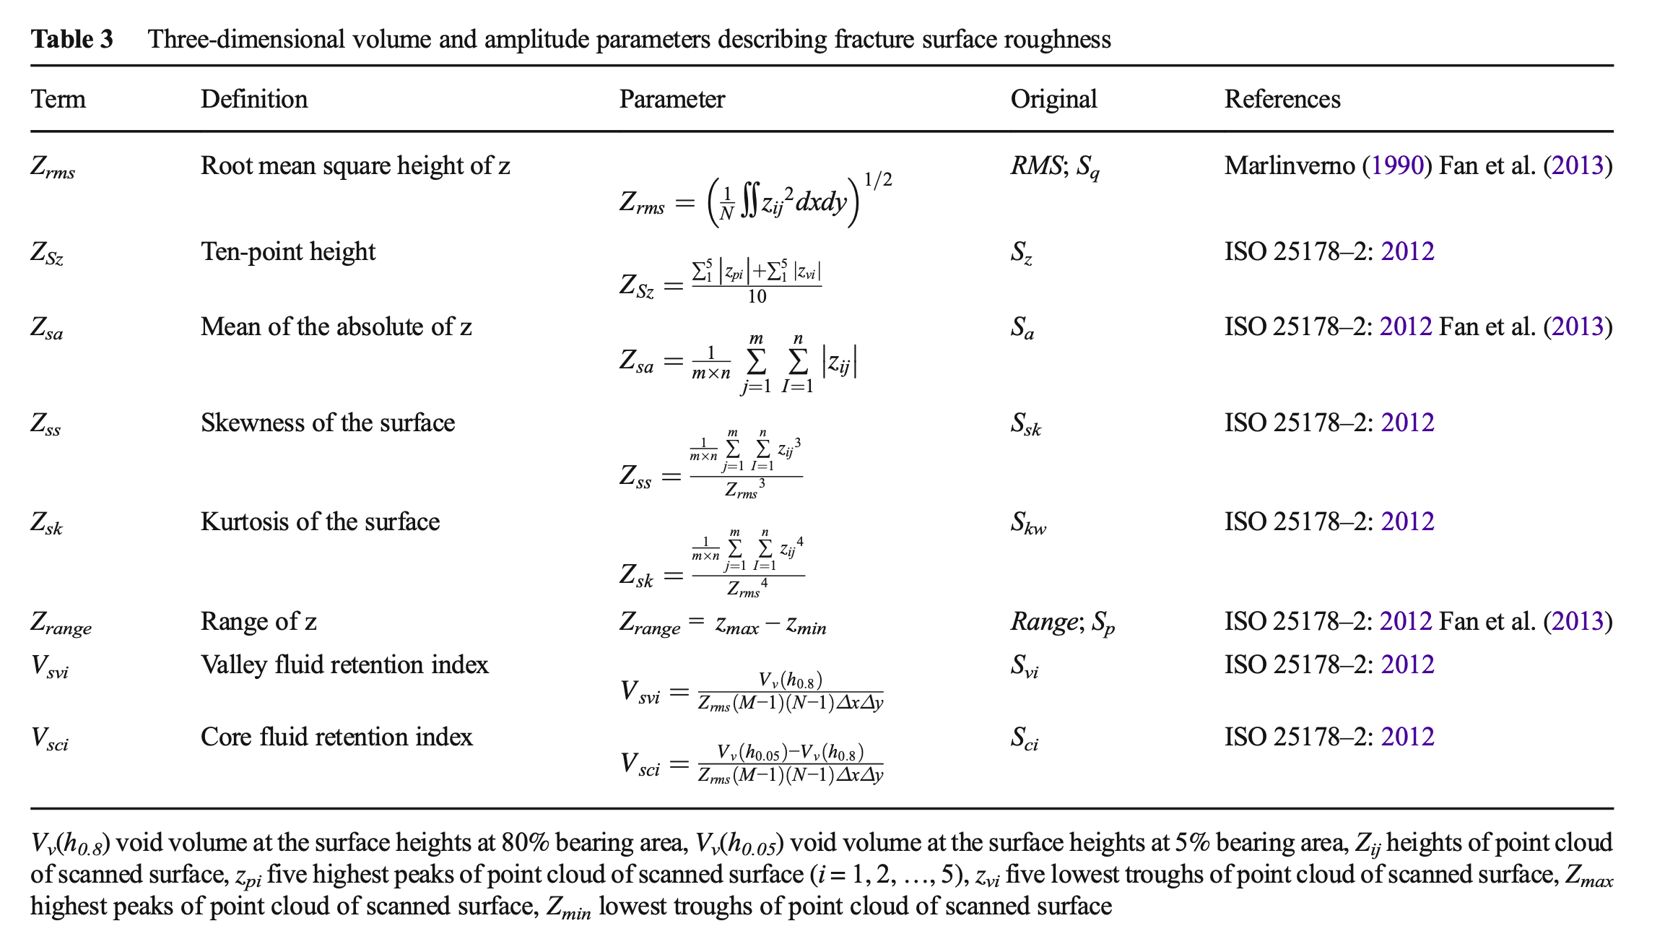
Surface Roughness Mesaurements
Surface roughness by amplitude

Slide 7
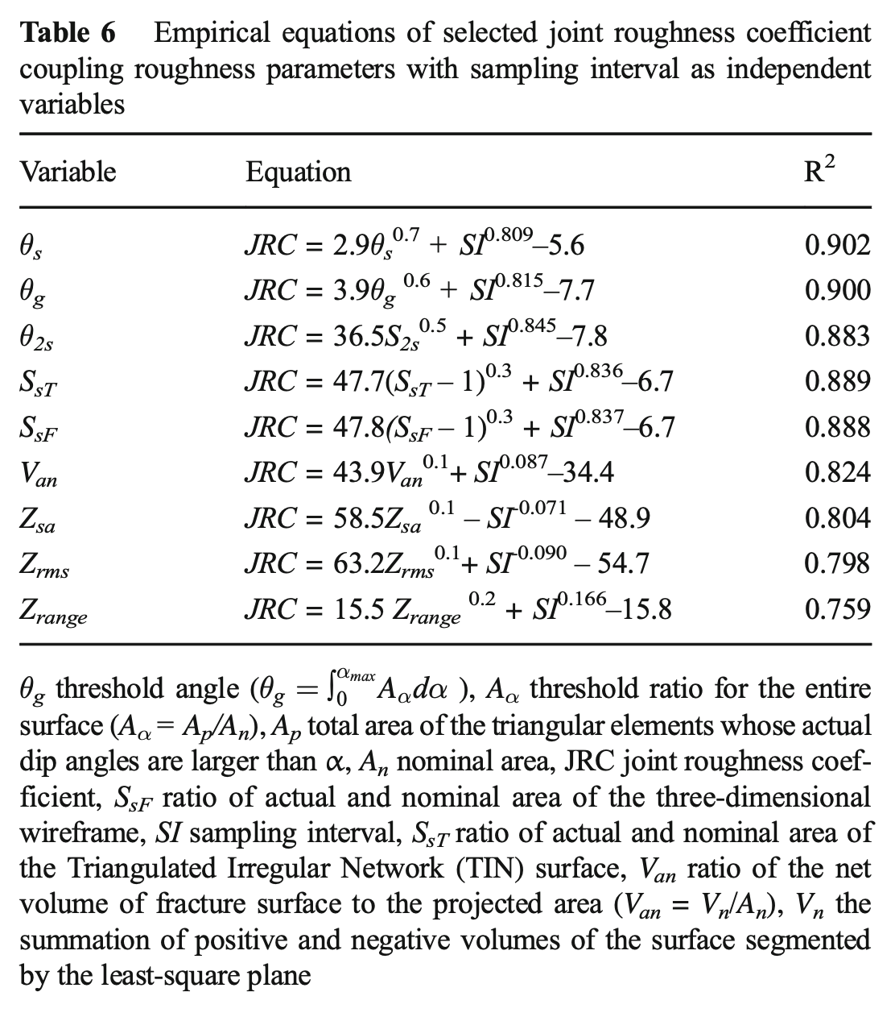
Surface Roughness Correlations

Slide 8
Measurement Plots

Slide 9
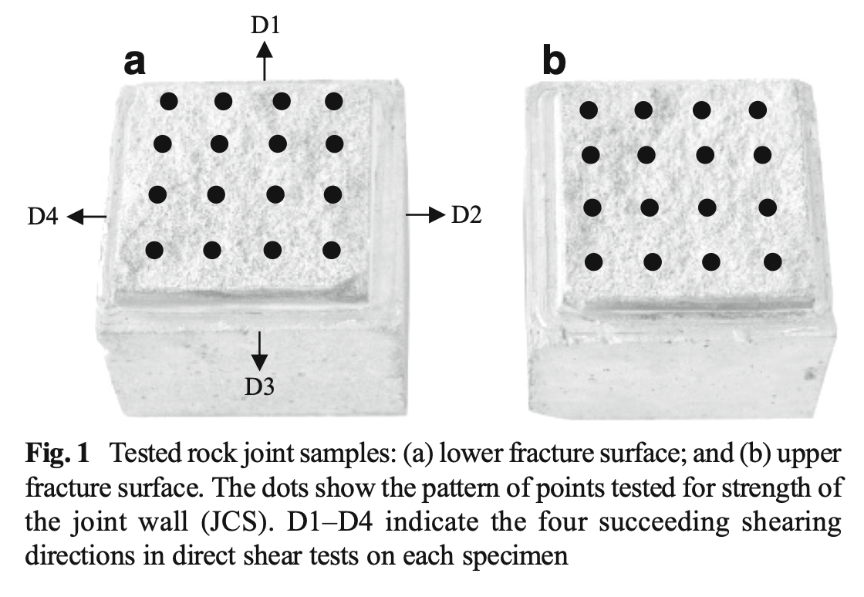
Results

Slide 10
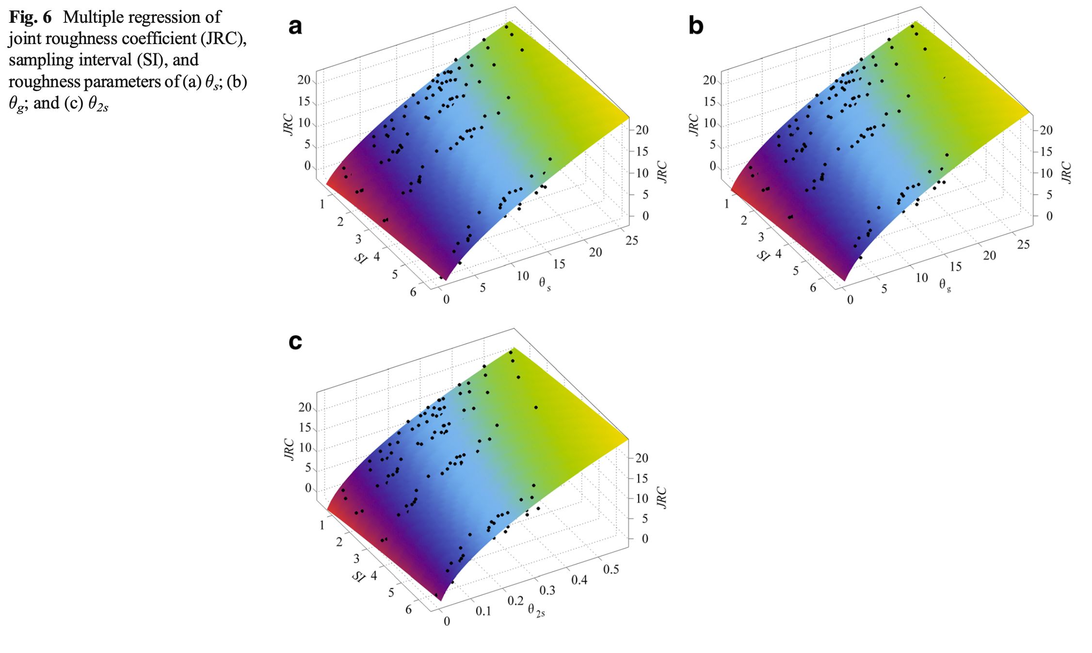
Results

Slide 11
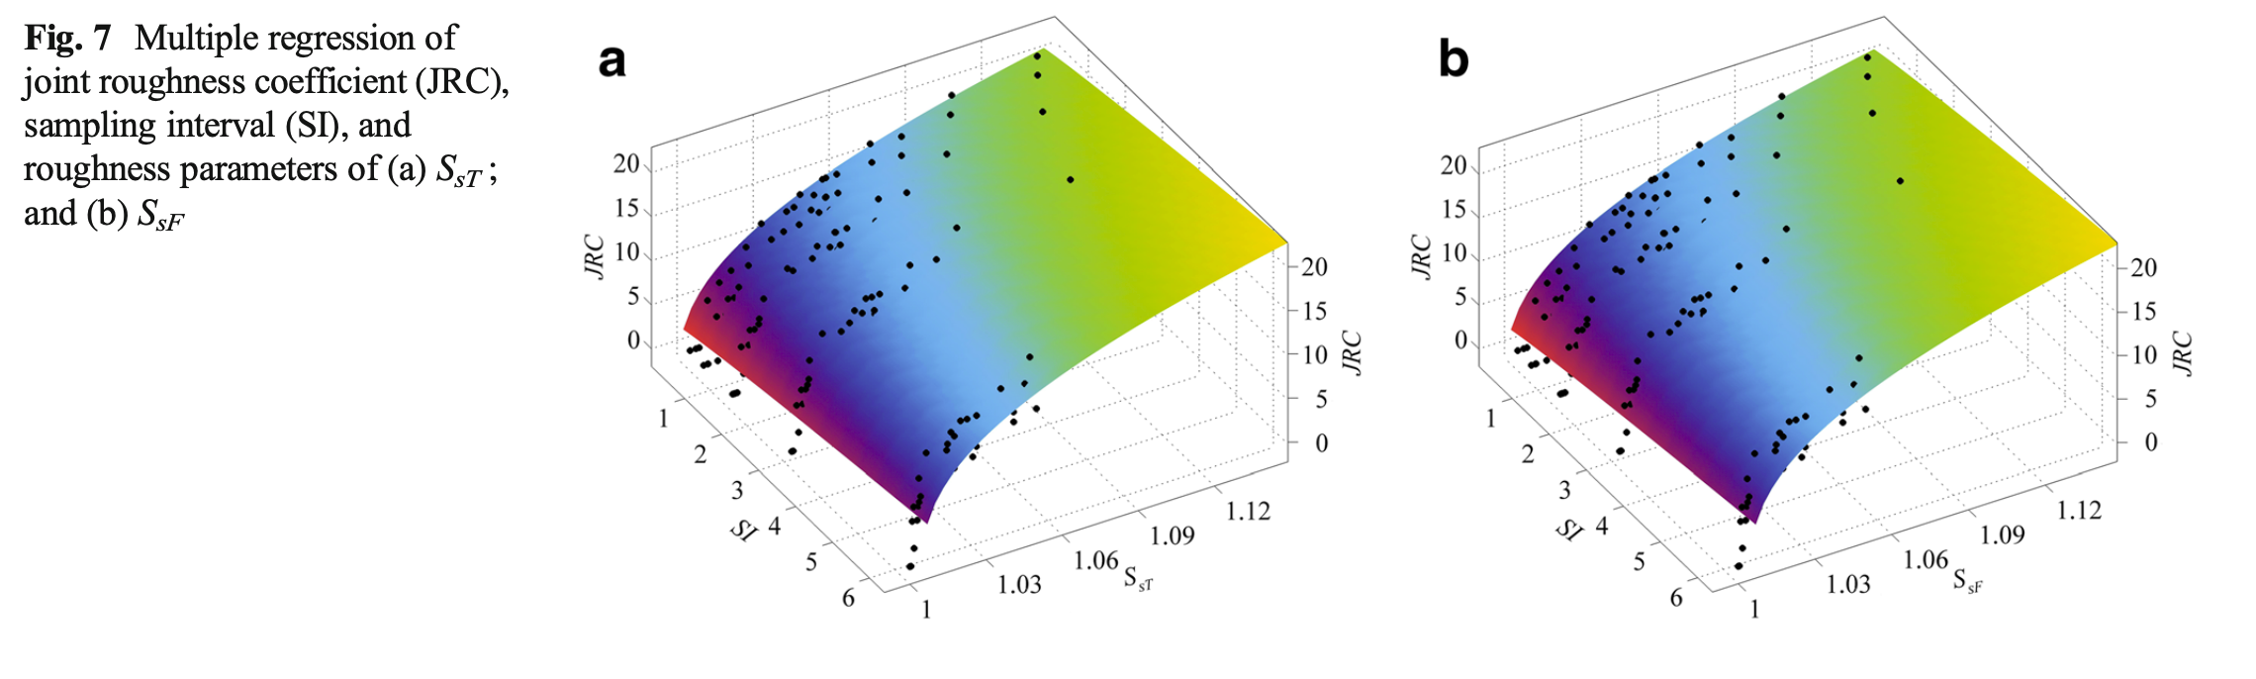
Results

Slide 12
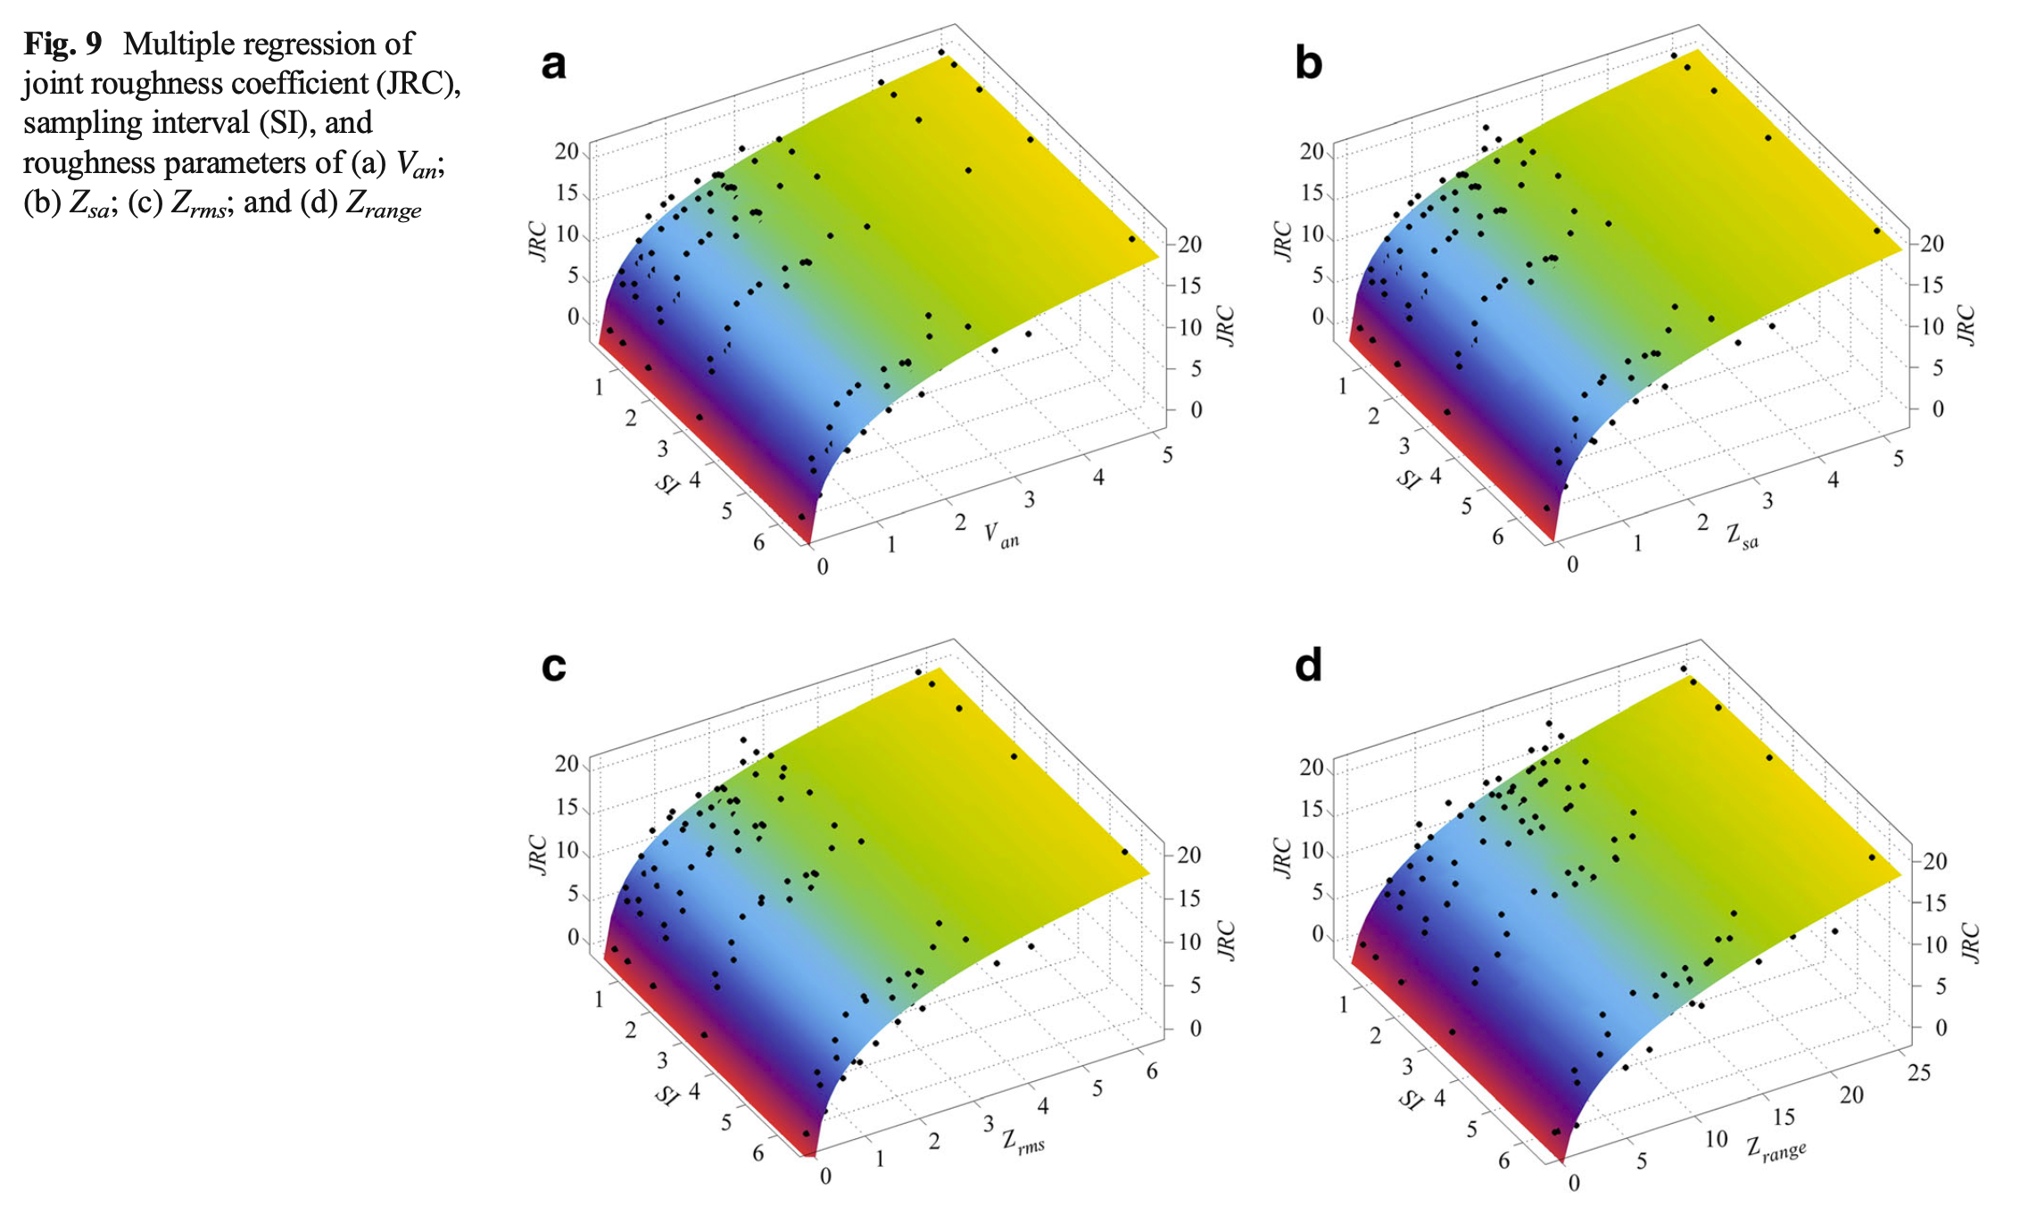
Results

Slide 13
Conclusions

Slide 14
Conclusion
Nine parameters (θs, θg, θ2s, SsT, SsF, Van, Zsa, Zrms, and Zrange) are found to have close correlations with JRC and are capable of estimating the JRC of rock fracture sur- faces. Other parameters (Zss, Zsk, Vsvi, Vsci, Sdr, and Sts) show no good correlations with JRC.
Slope parameters perform the best and the amplitude parameters perform the worst in terms of correlation coefficient.
The sampling interval has little influence when using volume and amplitude parameters (Van, Zsa, Zrms, and Zrange), while it influences to some extent when other parameters (θs, θg, θ2s, SsT, and SsF) are used.

Slide 15
Thank you!

